Slide 1
Gesture Controlled Car
Mohammad Areeb – 160403
Akanksha Makkar - 160062

Slide 2
The Problem
The problem is to design a car that can be controlled by simple hand gestures.
The user just needs to wear a gesture device in which a sensor is included. The sensor will record the movement of hand in a specific direction which will result in the motion of the car in the respective direction.
The car and the gesture instrument are connected wirelessly through radio waves.

Slide 3
Approach
The entire circuit is split into 2 parts – Transmitter Circuit, and Receiver Circuit.
Transmitter Circuit – Contains the main sensor(MPU6050) and microcontroller for getting input data from hand gestures, and sending it to the receiver circuit.
Receiver Circuit – Receives data from Transmitter circuit wirelessly, and uses it to drive the car accordingly using a motor driver IC.

Slide 4
Components Used
MPU-6050 Accelerometer Gyroscope IC
Arduino Nano Controller
HT12E Encoder IC
RF-433 Wi-Fi Transmitter Receiver Pair
HT12D Decoder IC
LM7805 – Voltage Regulator IC
L293D – Motor Driver IC
2 BO Motors
2 BO Motor Wheels
1 Supporting Front Wheel
9 Volt Batteries

Slide 5
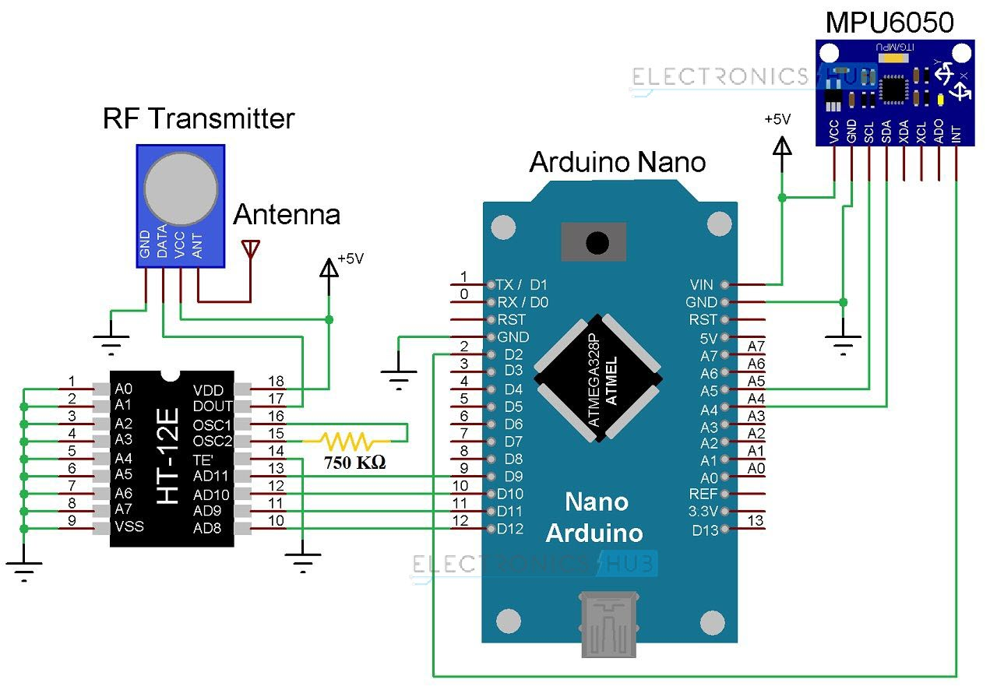
Prototype of Transmitter Circuit

Slide 6
Transmitter Circuit
MPU6050 IC is a 6DoF accelerometer-gyroscope IC used for measuring Pitch and Roll of the hand gestures.
MPU6050 uses I2C protocol to connect with Arduino Nano pins – A4 for Serial Data, and A5 for Serial Clock.
Arduino converts the raw data from MPU6050 to meaningful angles, and uses these values to control the car.
The above data is sent to an Encoder IC – HT12E which encodes the serial data to parallel.
This parallel data is fed to RF-433 Wi-Fi transmitter module which sends it to receiver circuit.

Slide 7
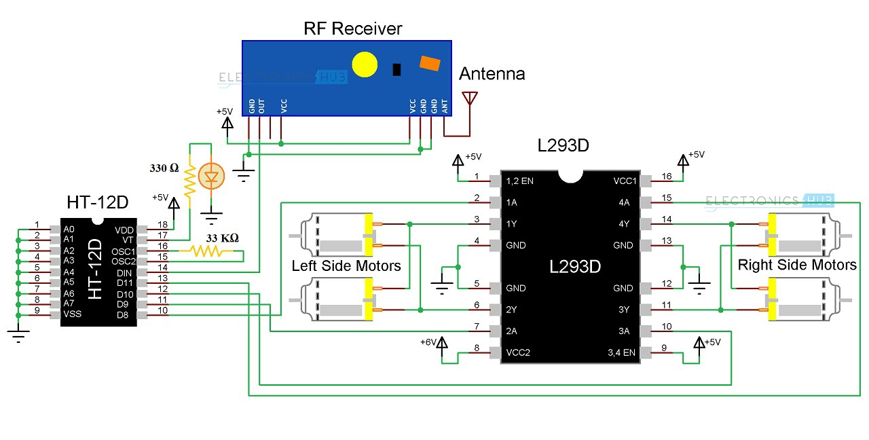
Prototype of Receiver Circuit

Slide 8
Receiver Circuit
The RF-433 Wi-Fi receiver module receives the transmitted data from receiver circuit and sends it to decoder IC.
Decoder IC HT12D decodes the serial data to parallel.
This data is sent to L293D motor driver IC which uses it to drive two BO motors attached to the car.
The motors are desired to run at 9V, however the Decoder IC works at 5V. Hence, a voltage regulator IC LM7805 is used to achieve this.

Slide 9
Block Diagram for Data Flow
MPU6050
Arduino Nano
Encoder HT12E
RF433
Wi-fi transmitter
Hand Gestures
RF433
Wi-fi Receiver
Decoder HT12D
Motor Driver L293D
Car

Slide 10
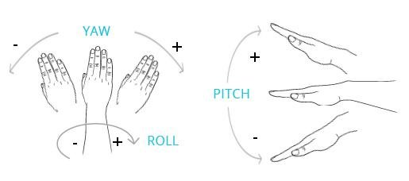
Results
The car is showing proper responses according to hand gestures.
Different hand gestures to make the car move in specific directions are as follows (we haven’t used Yaw gestures) :
BACKWARDS
STOP
TURN LEFT
TURN RIGHT
FORWARD

Slide 11
Problems with current design
The on-board batteries occupy a lot of space and are also quite heavy. We can either use some lighter batteries or replace the current DC Motors with ones which require less power.
Since we haven’t used proper antennas with the Wi-Fi module, the range of transmission isn’t very high. The receiver circuit won’t be having proper communication with the transmitter after a certain distance.

Slide 12
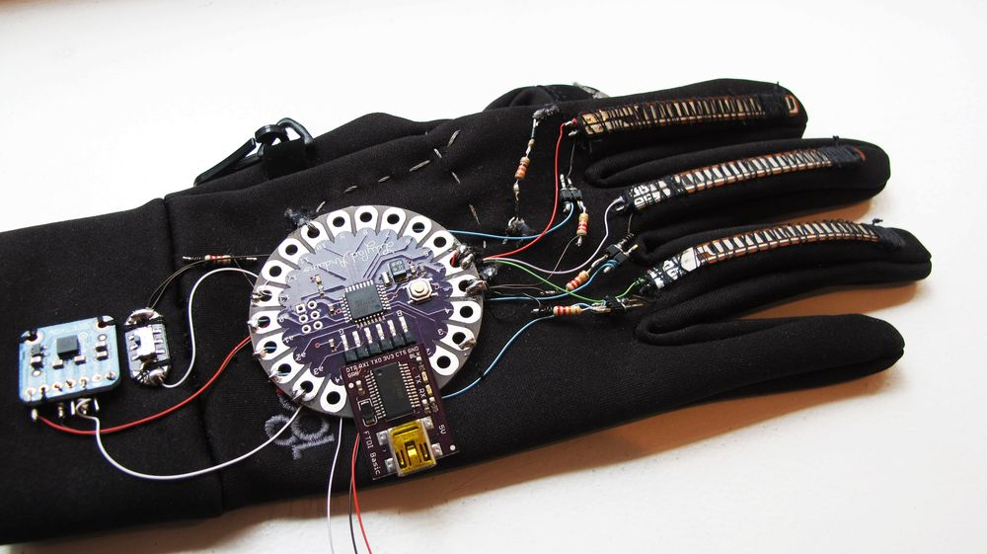
Suggested Improvements
We can simultaneously change the direction and move the car forward or backward. Also, the speed of the car can be controlled using the magnitude of pitch or roll.
The transmitter circuit to be designed as a hand-wearable using Arduino LilyPad.

Slide 13
References
https://www.engineersgarage.com/electronic-components/ht12d-datasheet
https://howtomechatronics.com/tutorials/arduino/how-i2c-communication-works-and-how-to-use-it-with-arduino/
https://www.dfrobot.com/wiki/index.php/How_to_Use_a_Three-Axis_Accelerometer_for_Tilt_Sensing

Slide 14
THANK YOU

